Slide 1
World War II
Camilla Bianchi (s4212100)
Caterina Lupo (s4220196)

Slide 2


HOMEPAGE
Welcome to our Visualization project.
The intent was to analyze and visualize facts and data about the World War II to better understand the impact of this huge war all over the world.
Choose one of these two pages to continue:
Map
Statistics

Slide 3
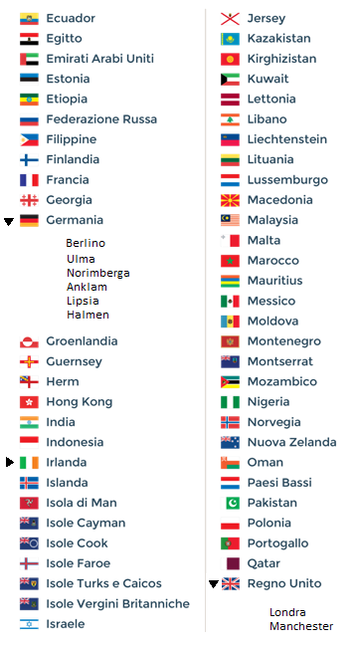
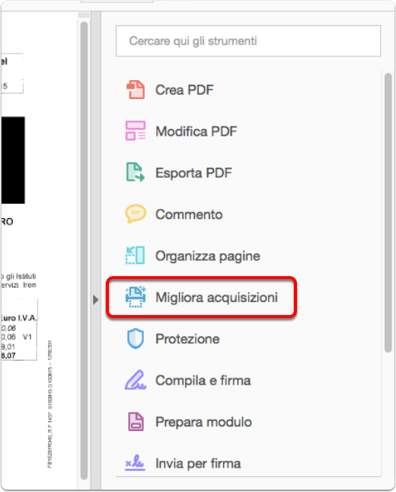
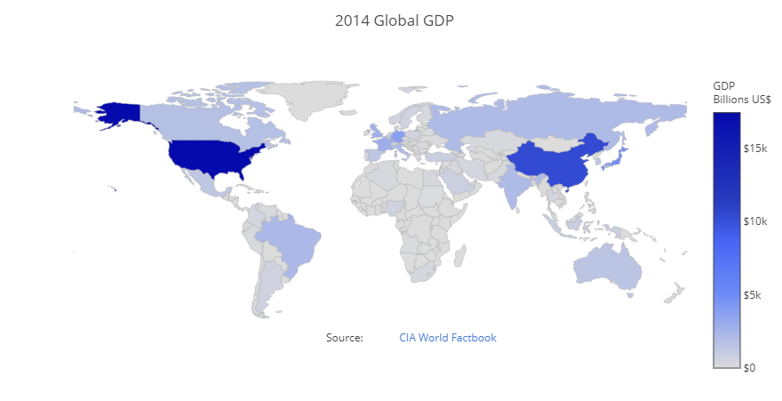




Multiple Selection of countries by menu – map View
Hide
2M
1M
500K
50K
5k
Zoom on last country selected
Notes:
I have thought to start from the main information provided by the dataset, so that the number of victims. I have chosen a classic barchart, where each entry involves two bars, the first for the civil victims and the second for the military ones.
So i have inserted a key to distinguish them. The colours could be grey and black, because,in my opinion they are more suitable for this topic.The Selected item may be filled with red, or anyway a colour more brilliant than the orange one that you can see on the first.
As i have explained previously, in this page the options are provided by these buttons.
So this is could be the situation after making this selections.
In victims for country visualisation, i would like to add some label that could help the users to recognize the country that belong to a formations. In the victimis for formations the vsualsition would be similar but with only 3 ntrys ( axis, allies

Slide 4
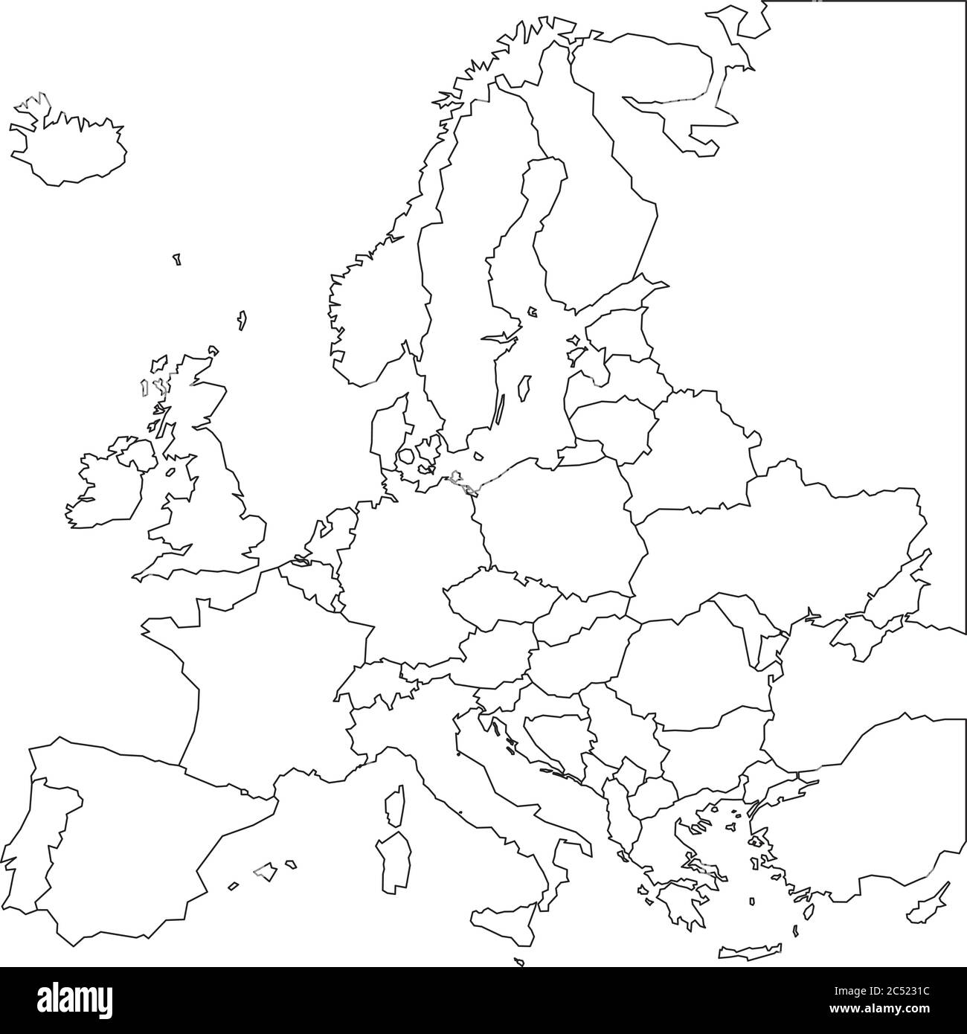
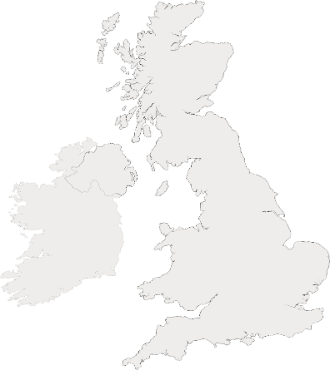
Events
GERMANY:
Ulma
UK:
Londra
Zoom in.
Select city on dialog menu.
Click on the city to display events.
Number of deaths
…
Cause of Death
...
Executors
…
Number of deaths
…
Cause of Death
...
Executors
…

Slide 5
Victims by division – Line chart
The Allies: UK, USA, URSS, China.
Axis powers: Italy, Germany, Japan.
X Axis: months of a year.
Y Axis: # victims.
Slider:
years of war.
1939 1940 1941 1942 1943 1944 1945 1946
Notes:
I have thought to start from the main information provided by the dataset, so that the number of victims. I have chosen a classic barchart, where each entry involves two bars, the first for the civil victims and the second for the military ones.
So i have inserted a key to distinguish them. The colours could be grey and black, because,in my opinion they are more suitable for this topic.The Selected item may be filled with red, or anyway a colour more brilliant than the orange one that you can see on the first.
As i have explained previously, in this page the options are provided by these buttons.
So this is could be the situation after making this selections.
In victims for country visualisation, i would like to add some label that could help the users to recognize the country that belong to a formations. In the victimis for formations the vsualsition would be similar but with only 3 ntrys ( axis, allies

Slide 6
Comparison of RELATIVE AND ABSOLUTE VICTIMS AS % – Bar chart
Radio button to navigate among these options:
Total victims.
Percentage of victims compare to the entire population for each country.
Percentage of victims compare to the total of victims for each country.
Total victims Victims as % of population in 1939 Victims as % of total death in 2WW
Notes:
I have thought to start from the main information provided by the dataset, so that the number of victims. I have chosen a classic barchart, where each entry involves two bars, the first for the civil victims and the second for the military ones.
So i have inserted a key to distinguish them. The colours could be grey and black, because,in my opinion they are more suitable for this topic.The Selected item may be filled with red, or anyway a colour more brilliant than the orange one that you can see on the first.
As i have explained previously, in this page the options are provided by these buttons.
So this is could be the situation after making this selections.
In victims for country visualisation, i would like to add some label that could help the users to recognize the country that belong to a formations. In the victimis for formations the vsualsition would be similar but with only 3 ntrys ( axis, allies

Slide 7


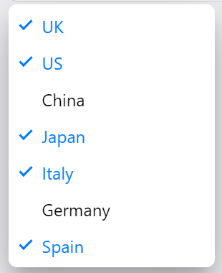
Victims for each country: Soldiers vs civilianS - stacked bar chart
Notes:
A stacked bar chart will show the total amount of victimis compared to the toal one. I have found it more efficient than a pie chart because it gives the same space to all the country, making the visualisation clearer.

Slide 8
Victims caused by Holocaust – Pie chart 3D
HUNGARY:
Number of deaths : 600.
Percentage: 2%;

